Slide 1
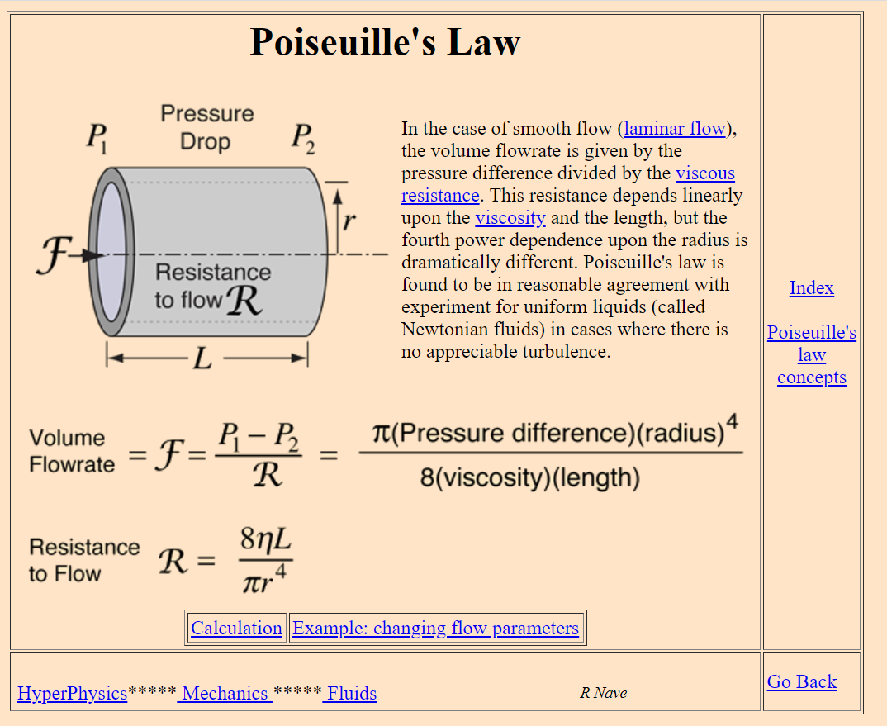
Electricity primer:
http://people.cs.georgetown.edu/~squier/Teaching/ComputerSystemsArchitecture/520-2013-CourseDocuments/Lec-1-electricityPrimer.pdf
Poiseuille’s Law
http://hyperphysics.phy-astr.gsu.edu/hbase/ppois.html
Notes:
Electricity primer:
http://people.cs.georgetown.edu/~squier/Teaching/ComputerSystemsArchitecture/520-2013-CourseDocuments/Lec-1-electricityPrimer.pdf
Poiseuille’s Law
http://hyperphysics.phy-astr.gsu.edu/hbase/ppois.html

Slide 2


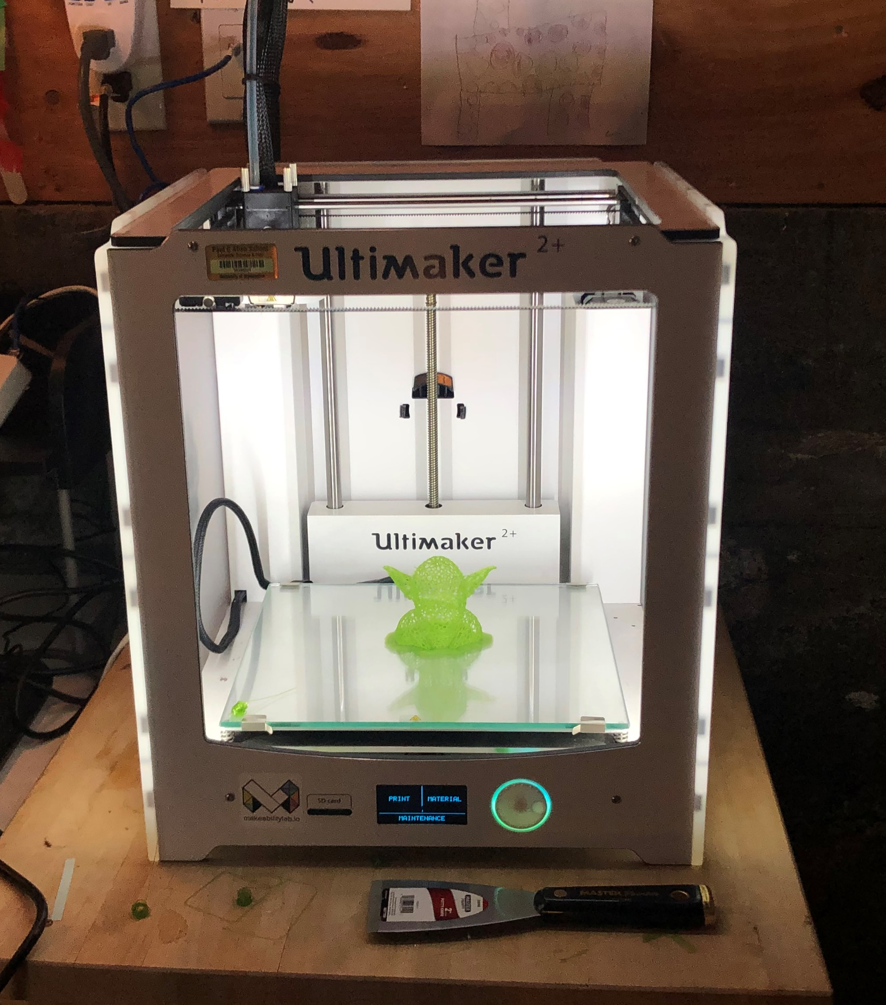
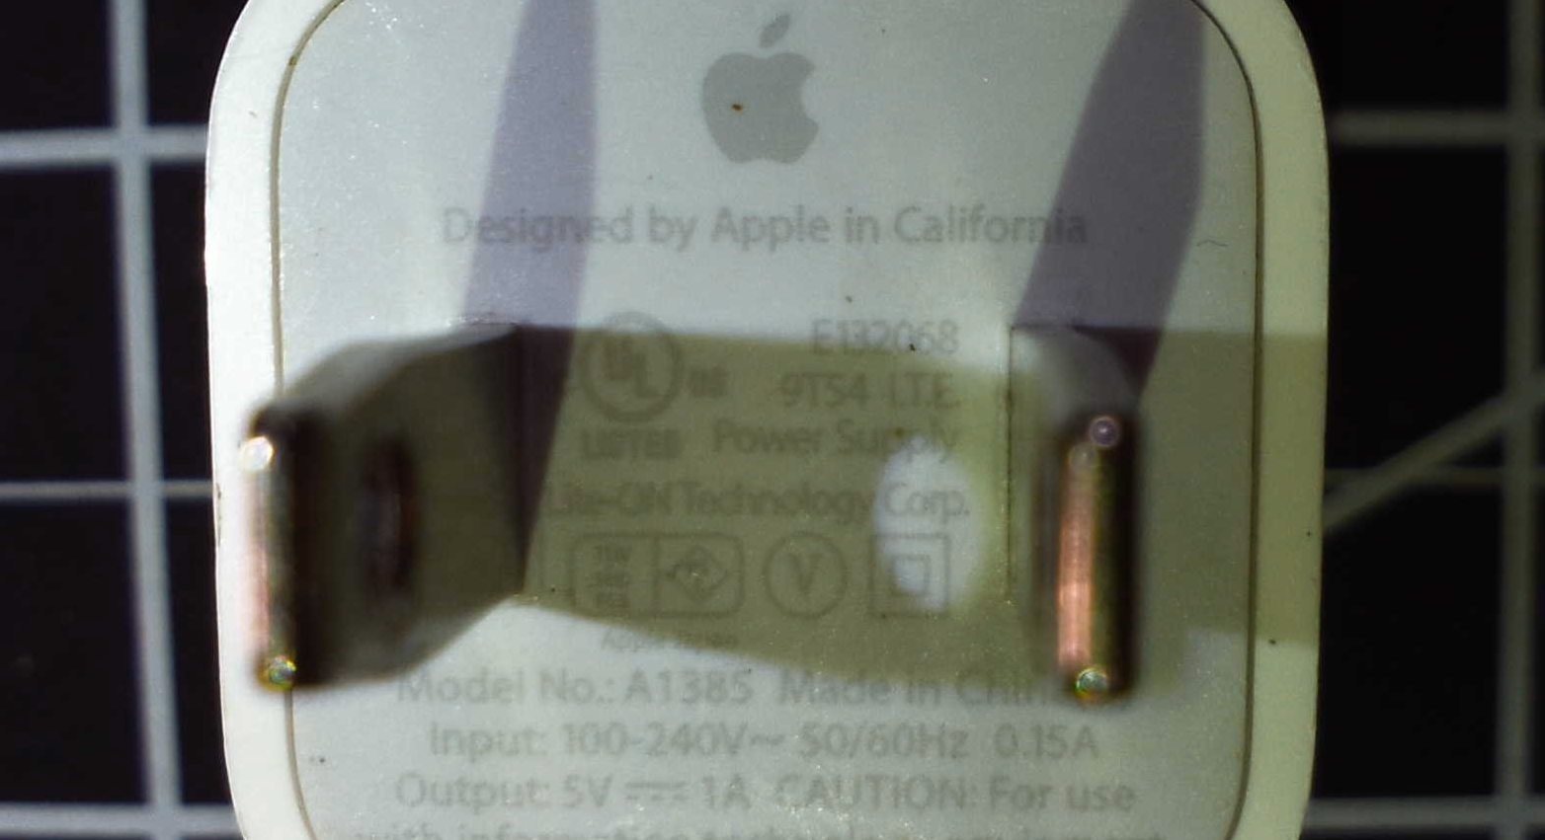
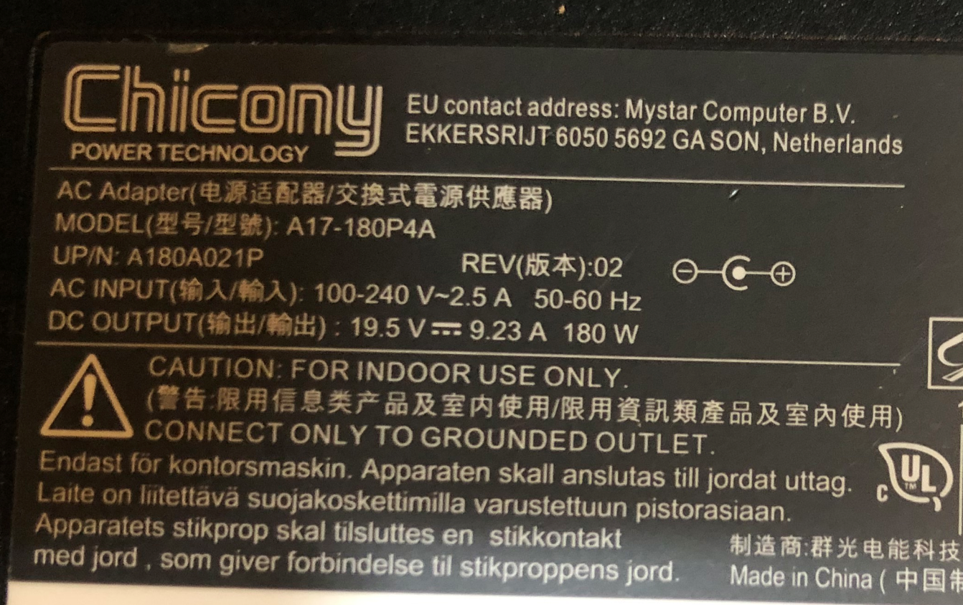
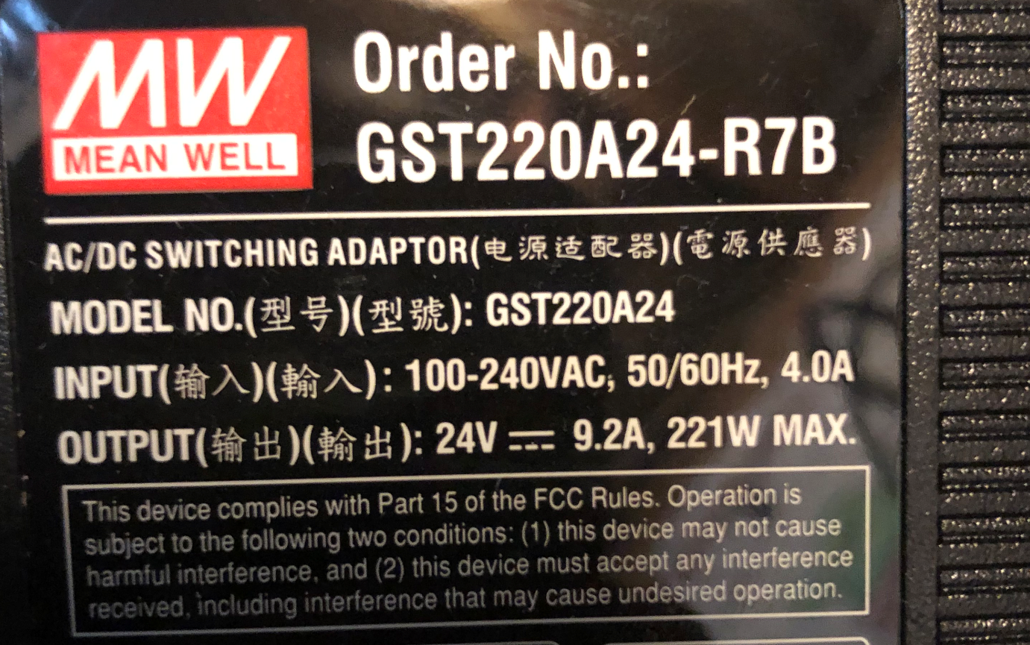
Apple iPhone
Windows Laptop
3D Printer
AC Input: 100-240V, 50/60Hz, 0.15A
DC Output: 5V, 1A
AC Input: 100-240V, 50/60Hz, 2.5A
DC Output: 19.5V, 9.23A
AC Input: 100-240V, 50/60Hz, 4A
DC Output: 24V, 9.2A

Slide 3
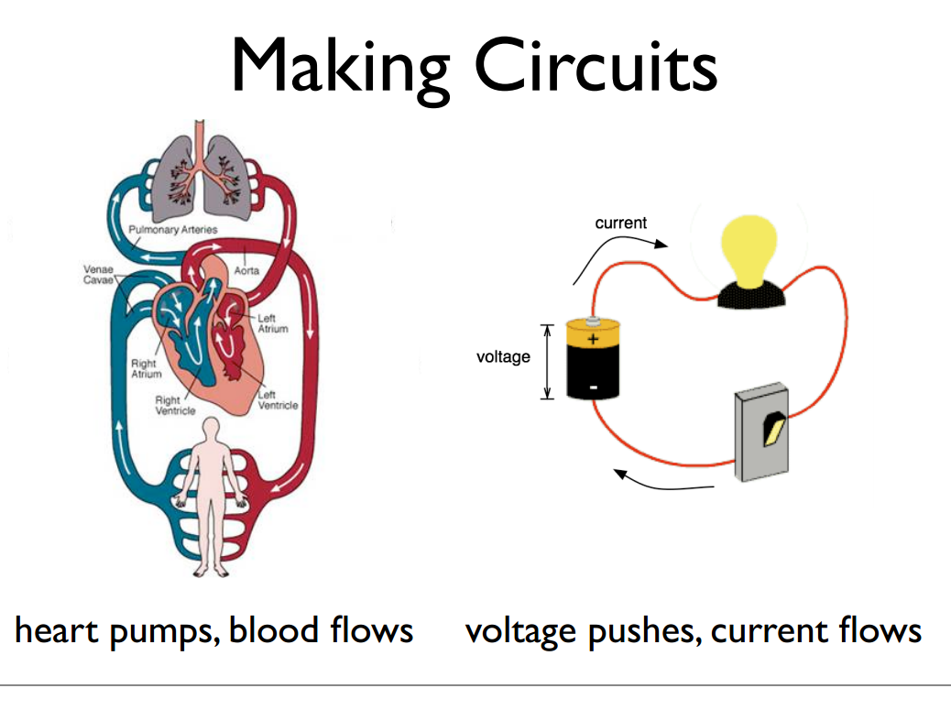
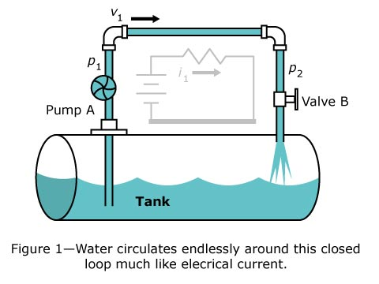
Human Circulatory System
Water Hydraulic System
Electrical circuits

Slide 4

A Circuit
cir∙cut [noun]
A route that starts and finishes at the same place.
- Oxford Dictionary

Slide 5
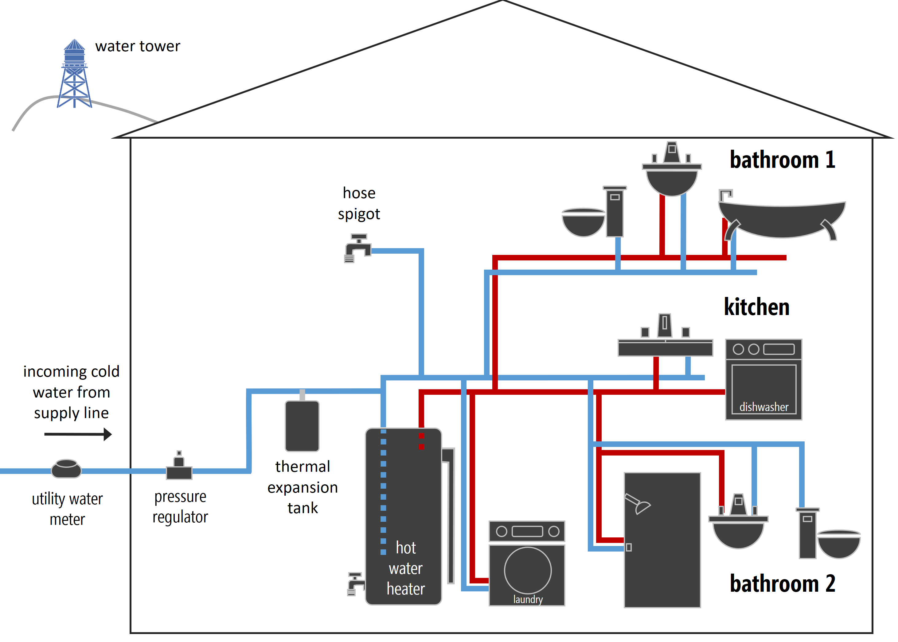
Some example circuits
Circuits
Human Circulatory System
Water Plumbing system
Electrical circuits
Electrical circuits
Heart pumps, blood flows
Water pressure pushes, water flows
Voltage pushes, current flows
Voltage pushes, current flows
Based on: http://todbot.com.s3.amazonaws.com/spookyarduino/arduino_spooky_projects_class1.pdf
Notes:
Source: http://todbot.com.s3.amazonaws.com/spookyarduino/arduino_spooky_projects_class1.pdf

Slide 6
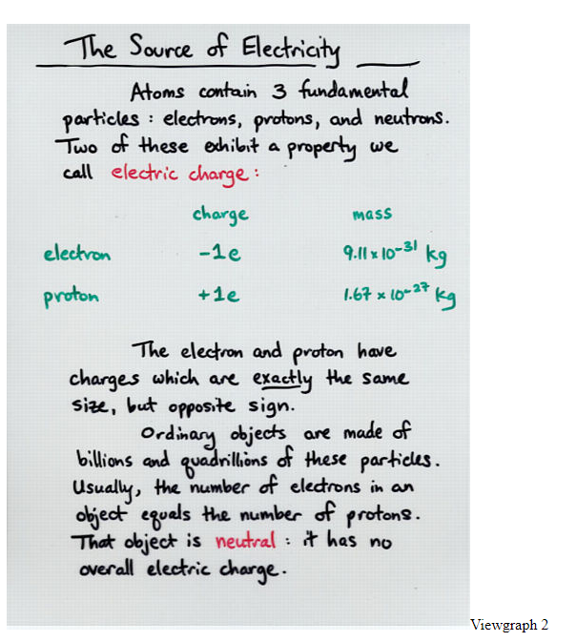
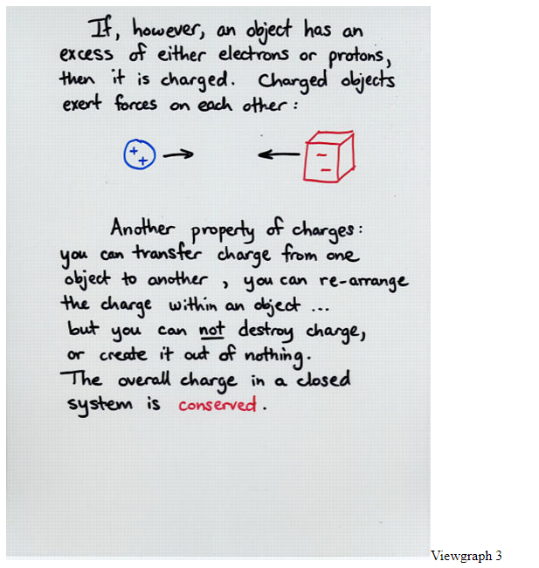
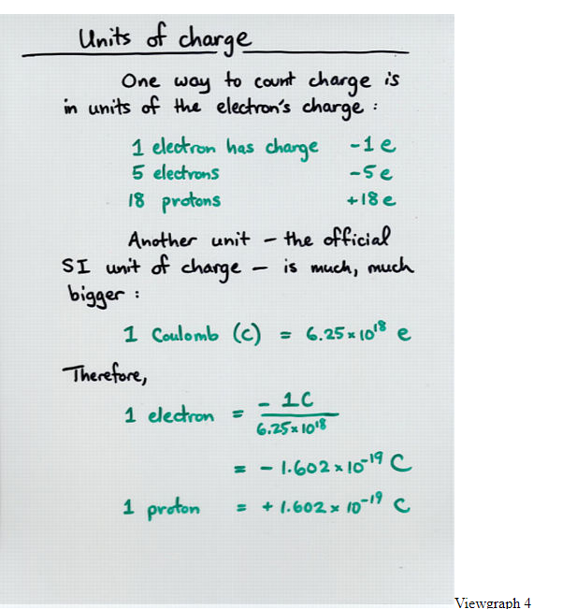
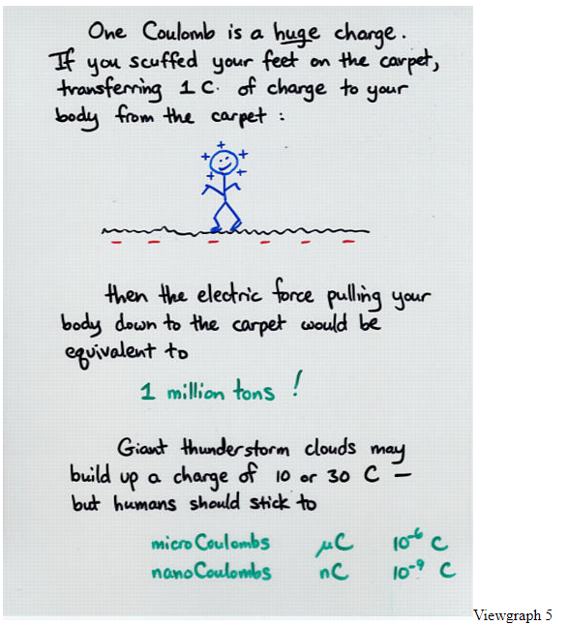
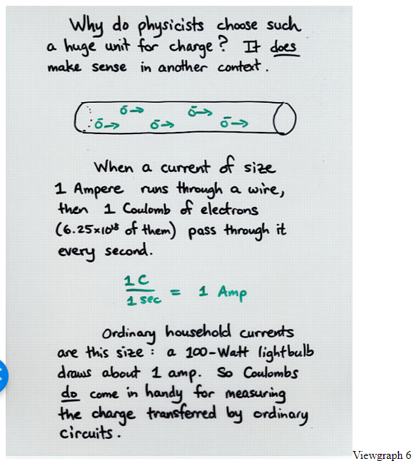
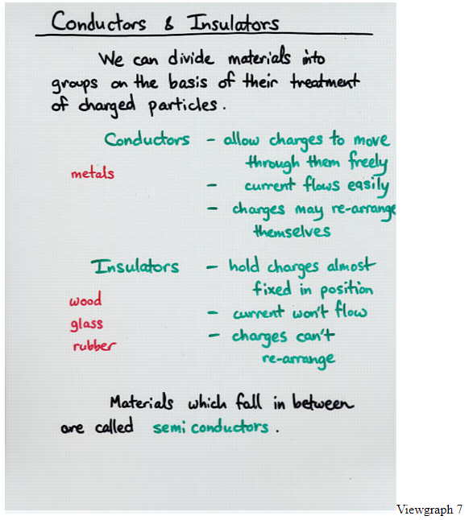
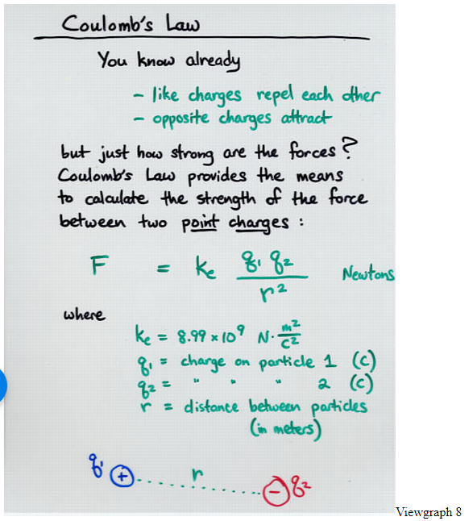
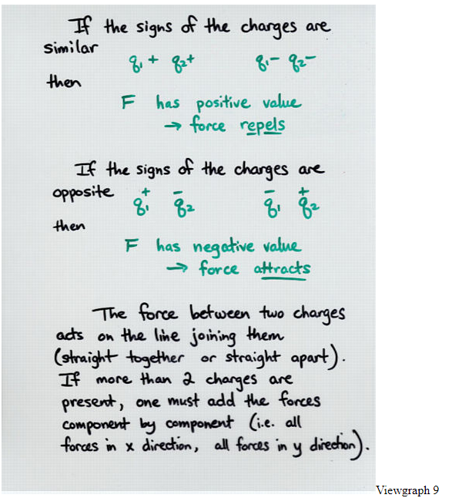

Slide 7
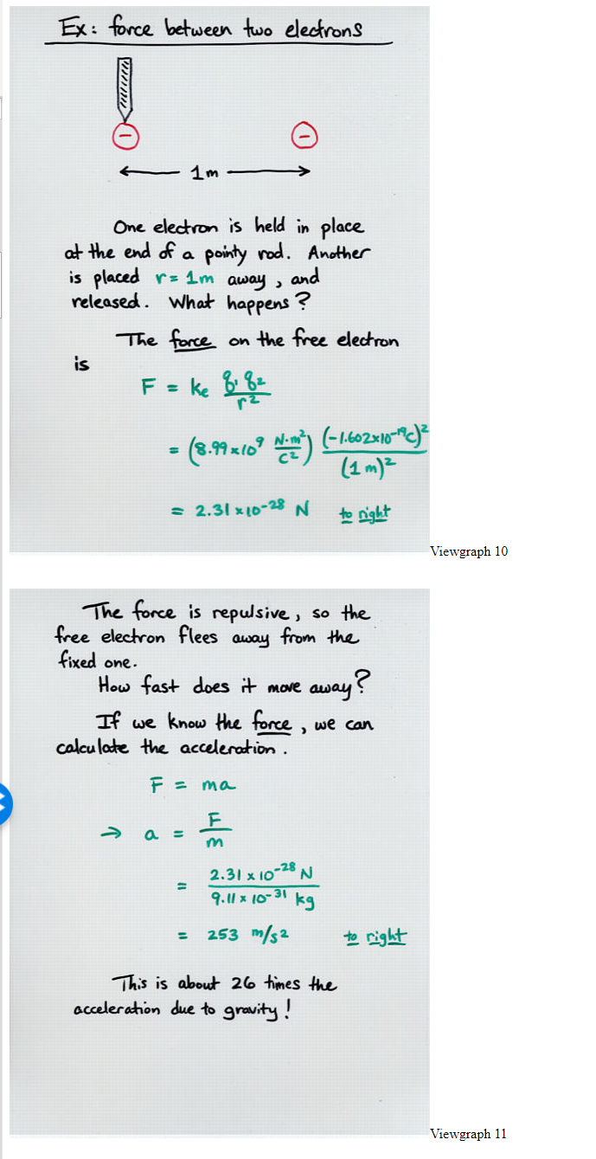
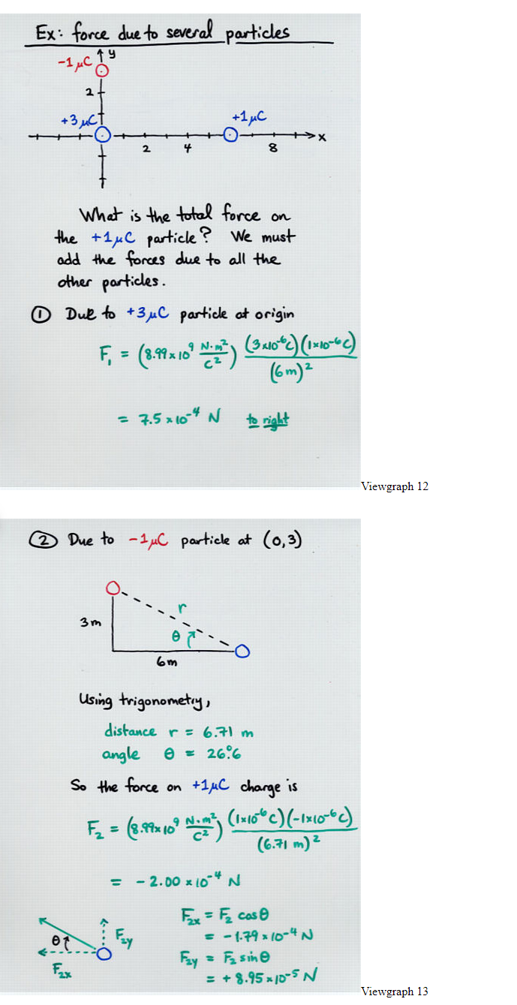
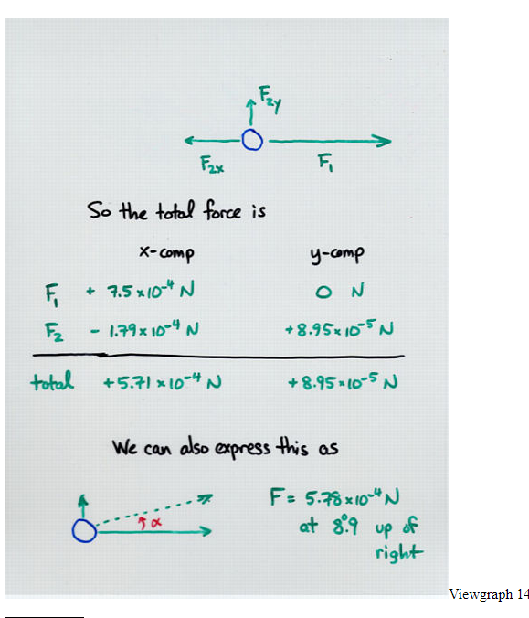
Notes:
http://spiff.rit.edu/classes/phys213/lectures/coul/coul_long_long.html

Slide 8
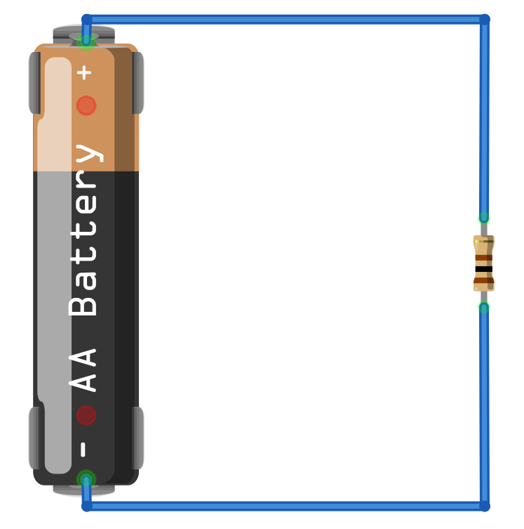
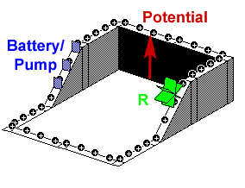
High potential
(positive terminal of battery)
+
+
+
+
+
+
+
+
+
+
Electric
potential
Conventional current
Resistor (R)
Resistors transform electrical energy into heat dropping the electric potential of the flowing charges
Low potential
(negative terminal of battery)

Slide 9
It takes work (like from a battery) to increase the electric potential of the charges
High potential
(positive terminal of battery)
+
+
+
+
+
+
+
+
+
+
Electric
potential
Conventional current
Resistor (R)
Resistors transform electrical energy into heat dropping the electric potential of the flowing charges
Low potential
(negative terminal of battery)
The charges here have zero electric potential (0V), we can call this ground

Slide 10
It takes work (like from a battery) to increase the electric potential of the charges
High potential
(positive terminal of battery)
+
+
+
+
+
+
+
+
+
+
Electric
potential
Conventional current
Resistor (R)
Resistors transform electrical energy into heat dropping the electric potential of the flowing charges
Low potential
(negative terminal of battery)
The charges here have zero electric potential (0V), we can call this ground

Slide 11
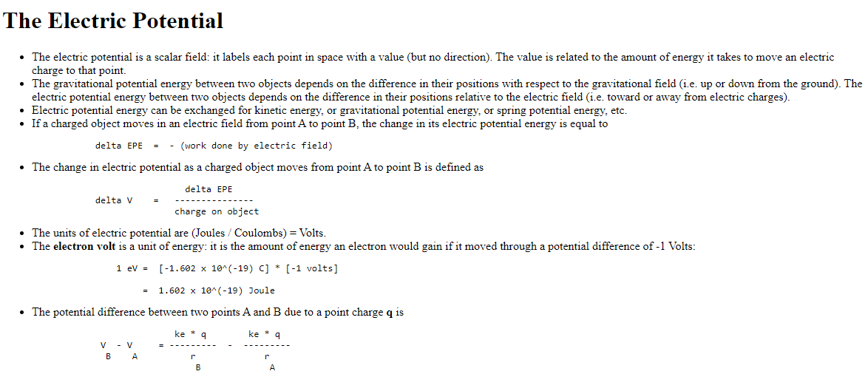
Notes:
http://spiff.rit.edu/classes/phys213/lectures/epot/epot_long_long.html

Slide 12
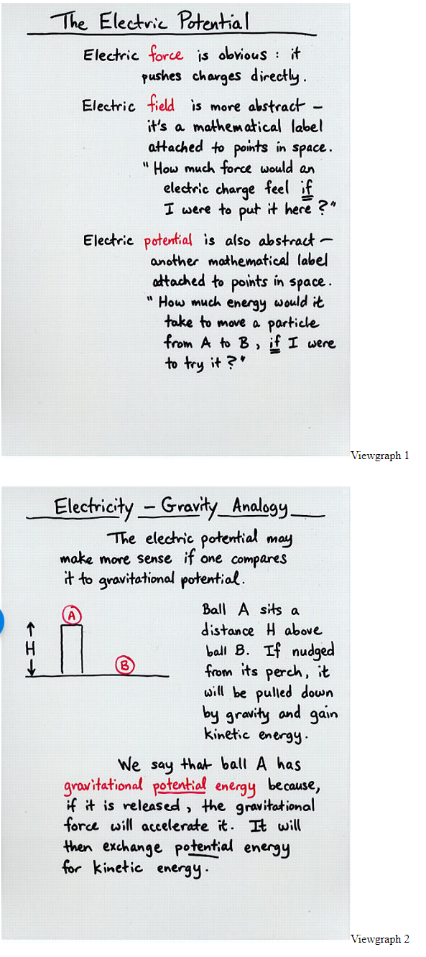
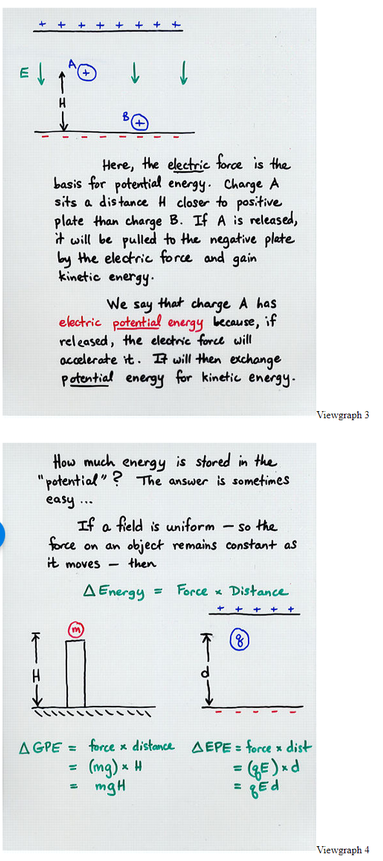
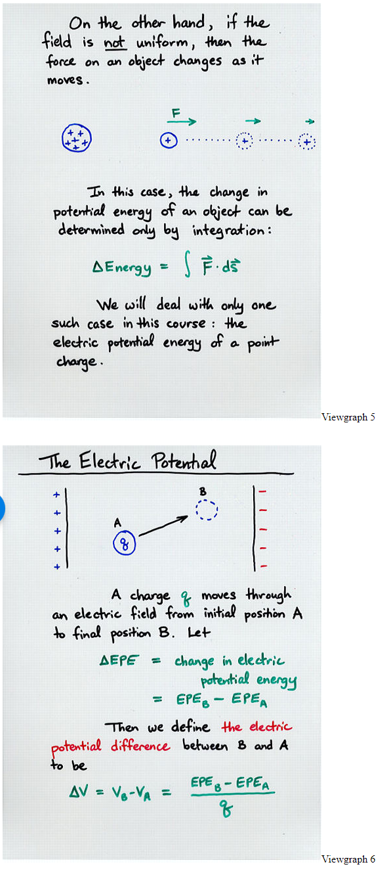
Notes:
http://spiff.rit.edu/classes/phys213/lectures/epot/epot_long_long.html

Slide 14
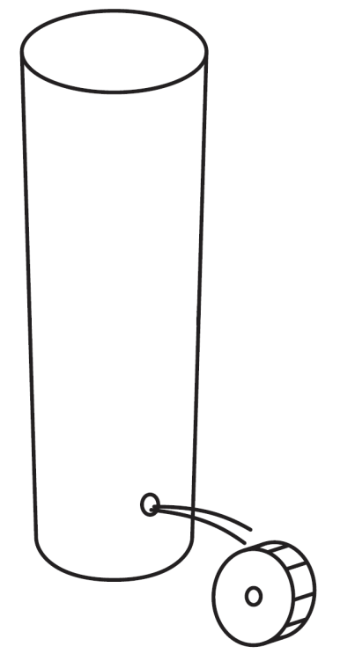

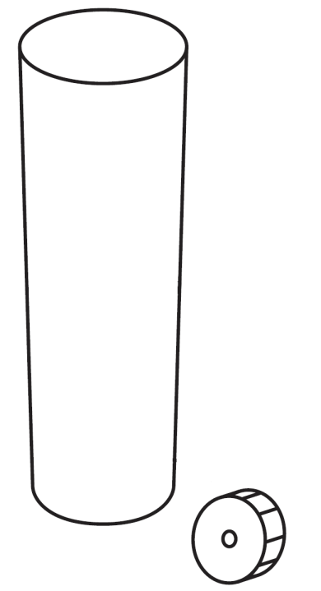
Two Ways to increase current
Circuits
Base Circuit
Method 1:
Increase Voltage
Method 2:
Decrease Resistance
Water level
Increase Water
Pressure
Water level
Water level
Hole width ≈ Resistance (R) (measured in ohms Ω)
Hole size held constant
Resistance decreased
Water Pressure ≈ Voltage (V) (measured in volts)
Voltage level held constant
Water Flow ≈ Current (I) (measured in amps)
Increased Flow
Increased Flow
1KΩ
1KΩ
100Ω
3V
~1mA
5V
~3mA
3V
~10mA
Voltage increased from 3V to 5V
Resistance reduced from 1KΩ to 100Ω
Based on figures from: Platt, Make: Electronics, 1st Edition

Slide 15

Circuit 1:
Basic Circuit
Circuit 2:
Increase Voltage
Circuit 3:
Decrease Resistance
Water level (pressure) is held constant. Assume same amount of water is added to tank as is exiting at bottom in both scenarios.
Water level
As the water level increases, so too does the “pressure” of the water at the bottom of the tank (due to increasing amounts of weight).
Increasing the water level, will produce more pressure and “force” out more water (higher current)
Water level same as Circuit 1
Increased water
pressure
Hole width ≈ Resistance (R) (measured in ohms Ω)
Hole size (resistance) held constant
Resistance decreased
(hole size larger)
Water Pressure ≈ Voltage (V) (measured in volts)
Voltage level held constant
Water Flow ≈ Current (I) (measured in amps)
Increased Flow
Increased Flow
1KΩ
1KΩ
100Ω
3V
~1mA
5V
~3mA
3V
~10mA
Voltage increased from 3V to 5V
Resistance reduced from 1KΩ to 100Ω
Based on figures from: Platt, Make: Electronics, 1st Edition

Slide 16
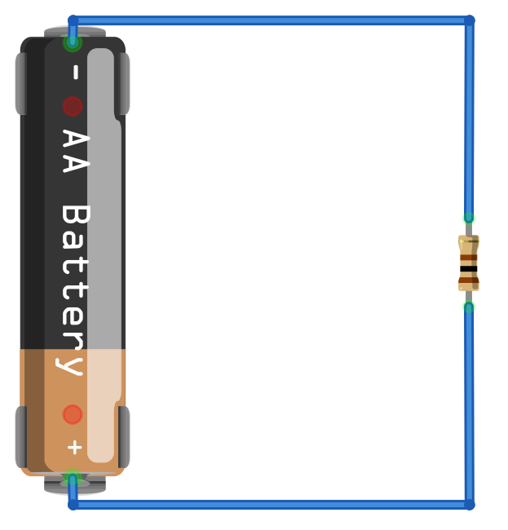
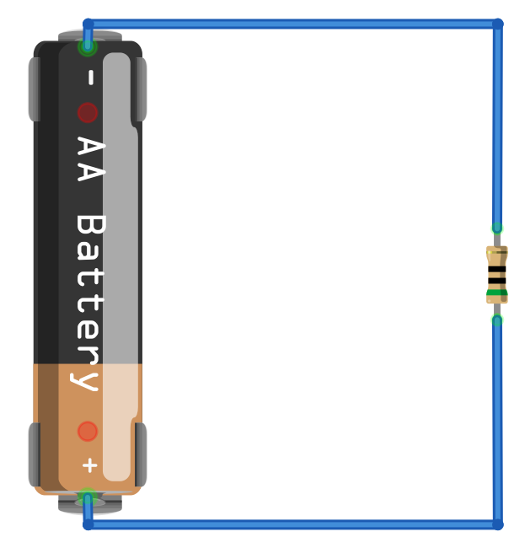
Circuit 1:
Basic Circuit
Circuit 2:
Increase Voltage
Circuit 3:
Decrease Resistance
Water level (pressure) is held constant. Assume same amount of water is added to tank as is exiting at bottom in both scenarios.
Water level
As the water level increases, so too does the “pressure” of the water at the bottom of the tank (due to increasing amounts of weight).
Increasing the water level, will produce more pressure and “force” out more water (higher current)
Water level same as Circuit 1
Lowest pressure
(at top of water level)
Increased water
pressure
Water Pressure ≈ Voltage (V) (measured in volts)
Hole width ≈ Resistance (R) (measured in ohms Ω)
Hole size (resistance) held constant
Resistance decreased
(hole size larger)
Voltage level held constant
Highest pressure
(at bottom of tank)
Water Flow ≈ Current (I) (measured in amps)
Increased Flow
Increased Flow
Lowest pressure
(negative terminal of battery)
0V
0V
I = 15mA
R = 100Ω
I = 30mA
R = 50Ω
Highest pressure
(positive terminal of battery)
1.5V
1.5V
Based on figures from: Platt, Make: Electronics, 1st Edition

Slide 17
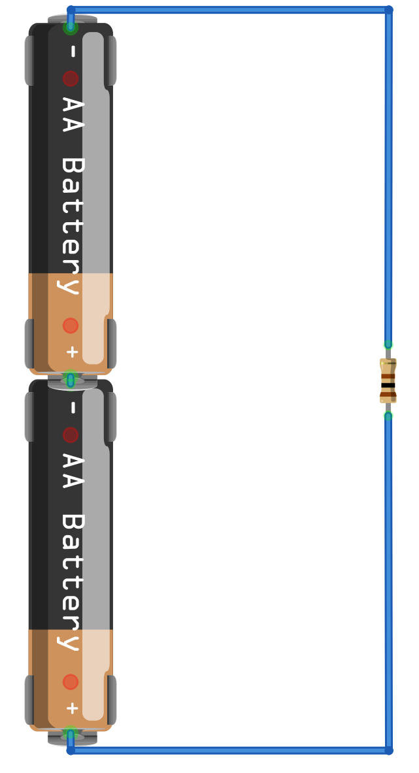

Circuit 1: Basic Circuit
Circuit 2: Increase Voltage
Circuit 3: Decrease Resistance
Water level (pressure) is held constant. Assume same amount of water is added to tank as is exiting at bottom in both scenarios.
Water level
As the water level increases, so too does the “pressure” of the water at the bottom of the tank (due to increasing amounts of weight), which will “push” more water out of the tank (increasing flow)
Increasing the water level, will produce more pressure and “force” out more water (higher current)
Lowest pressure
(at top of water level)
Water level same as Circuit 1
Hole width ≈ Resistance (R) (measured in ohms Ω)
Increased water
pressure (more voltage)
Hole size (resistance) held constant
Resistance decreased
(hole size larger)
Water level held constant
Highest pressure
(at bottom of tank)
Water Flow ≈ Current (I) (measured in amps or A)
Increased flow
Increased flow
Lowest pressure
(negative terminal of battery)
0V
0V
0V
Stack two batteries in series to increase electrical pressure (more voltage)
Voltage level held constant
(same as Circuit 1)
I = 15mA
R = 100Ω
I = 30mA
R = 100Ω
I = 30mA
R = 50Ω
Resistor held constant (same as Circuit 1)
Resistor decreased (half of Circuit 1)
Increased
current
(double Circuit 1)
Increased current
(double Circuit 1)
Highest pressure
(positive terminal of battery)
1.5V
1.5V
3V
Based on figures from: Platt, Make: Electronics, 1st Edition

Slide 18
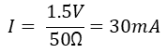
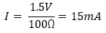
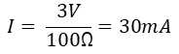
Circuit 1: Basic Circuit
Circuit 2: Increase Voltage
Circuit 3: Decrease Resistance
Water level (pressure) is held constant by adding same amount of to tank as is exiting at bottom through the hole.
Water level
As the water level increases, so too does the “pressure” of the water at the bottom of the tank (due to increasing amounts of weight), which will “push” more water out of the tank (increasing flow)
Increasing the water level, will produce more pressure and “force” out more water (higher current)
Lowest pressure
(at top of water level)
Water level same as Circuit 1
Hole width ≈ Resistance (R) (measured in ohms Ω)
Increased water
pressure (more voltage)
Hole size (resistance) held constant
Resistance decreased
(hole size larger)
Water level held constant
Highest pressure
(at bottom of tank)
Water Flow ≈ Current (I) (measured in amps or A)
Increased flow
Increased flow
Lowest pressure
(negative terminal of battery)
0V
0V
0V
Resistor held constant (same as Circuit 1)
Resistor decreased (half of Circuit 1)
Stack two batteries in series to increase electrical pressure (more voltage)
Voltage level held constant
(same as Circuit 1)
I = 15mA
R = 100Ω
I = 30mA
R = 100Ω
I = 30mA
R = 50Ω
$$I= \frac{1.5V}{100\text{Ω}}=15mA$$
Increased
current
(double Circuit 1)
Increased current
(double Circuit 1)
$$I= \frac{1.5V}{50\text{Ω}}=30mA$$
Highest pressure
(positive terminal of battery)
1.5V
1.5V
3V
$$I= \frac{3V}{100\text{Ω}}=30mA$$
Based on figures from: Platt, Make: Electronics, 1st Edition

Slide 19
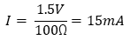
Circuit 1: Basic Circuit
Water level
As the water level increases, so too does the “pressure” of the water at the bottom of the tank (due to increasing amounts of weight), which will “push” more water out of the tank (increasing flow)
Lowest pressure
(negative terminal of battery)
0V
I = 15mA
R = 100Ω
Lowest pressure
(at top of water level)
Hole width ≈ Resistance (R) (measured in ohms Ω)
Voltage
$$I= \frac{1.5V}{100\text{Ω}}=15mA$$
Highest pressure
(positive terminal of battery)
1.5V
Highest pressure
(at bottom of tank)
Water Flow ≈ Current (I) (measured in amps or A)
Based on figures from: Platt, Make: Electronics, 1st Edition

Slide 20
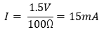
Circuit 1: Basic Circuit
Water level
As the water level increases, so too does the “pressure” of the water at the bottom of the tank (due to increasing amounts of weight), which will “push” more water out of the tank (increasing flow)
Assume water level (and the resulting pressure) is held constant by adding same amount of to tank as is exiting at bottom through the hole.
Lowest pressure
(negative terminal of battery)
0V
I = 15mA
R = 100Ω
Lowest pressure
(at top of water level)
Hole width ≈ Resistance (R) (measured in ohms Ω)
Voltage
$$I= \frac{1.5V}{100\text{Ω}}=15mA$$
Highest pressure
(positive terminal of battery)
1.5V
Highest pressure
(at bottom of tank)
Water Flow ≈ Current (I) (measured in amps or A)
Based on figures from: Platt, Make: Electronics, 1st Edition

Slide 21
Circuit 2: Increase Voltage
0V
Increasing the water level, will produce more pressure and “force” out more water (higher current)
Stack two batteries in series to increase electrical pressure (more voltage)
Increased water
pressure (more voltage)
Hole size (resistance) held constant
Increased flow
(compared to Circuit 1)
3V
Based on figures from: Platt, Make: Electronics, 1st Edition

Slide 22
Circuit 2: Increase Voltage
0V
Increasing the water level, will produce more pressure and “force” out more water (higher current)
Resistor held constant (same as Circuit 1)
Stack two batteries in series to increase electrical pressure (more voltage)
I = 30mA
R = 100Ω
Increased water
pressure (more voltage)
Hole size (resistance) held constant
Increased
current
(double Circuit 1)
Increased flow
(compared to Circuit 1)
3V
$$I= \frac{3V}{100\text{Ω}}=30mA$$
Based on figures from: Platt, Make: Electronics, 1st Edition

Slide 23
Circuit 3: Decrease resistance
Resistor decreased (half of Circuit 1)
Water level same as Circuit 1
R = 50Ω
Resistance decreased
(hole size larger)
Voltage
Increased flow
(compared to Circuit 1)
Based on figures from: Platt, Make: Electronics, 1st Edition

Slide 24
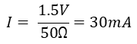
Circuit 3: Decrease resistance
0V
Resistor decreased (half of Circuit 1)
Voltage level held constant
(same as Circuit 1)
Water level same as Circuit 1
I = 30mA
R = 50Ω
Resistance decreased
(hole size larger)
Water pressure (voltage) same as Circuit 1
Increased current
(double Circuit 1)
$$I= \frac{1.5V}{50\text{Ω}}=30mA$$
1.5V
Increased flow
(compared to Circuit 1)
Based on figures from: Platt, Make: Electronics, 1st Edition

Slide 25
Circuit 1: Basic Circuit
Circuit 2: Increase Voltage
Circuit 3: Decrease Resistance
Water level (pressure) is held constant by adding same amount of to tank as is exiting at bottom through the hole.
Water level
As the water level increases, so too does the “pressure” of the water at the bottom of the tank (due to increasing amounts of weight), which will “push” more water out of the tank (increasing flow)
Increasing the water level, will produce more pressure and “force” out more water (higher current)
Lowest pressure
(at top of water level)
Water level same as Circuit 1
Hole width ≈ Resistance (R) (measured in ohms Ω)
Increased water
pressure (more voltage)
Hole size (resistance) held constant
Resistance decreased
(hole size larger)
Water level held constant
Highest pressure
(at bottom of tank)
Water Flow ≈ Current (I) (measured in amps or A)
Increased flow
Increased flow
Lowest pressure
(negative terminal of battery)
0V
0V
0V
Resistor held constant (same as Circuit 1)
Resistor decreased (half of Circuit 1)
Stack two batteries in series to increase electrical pressure (more voltage)
Voltage level held constant
(same as Circuit 1)
I = 15mA
R = 100Ω
I = 30mA
R = 100Ω
I = 30mA
R = 50Ω
$$I= \frac{1.5V}{100\text{Ω}}=15mA$$
Increased
current
(double Circuit 1)
Increased current
(double Circuit 1)
$$I= \frac{1.5V}{50\text{Ω}}=30mA$$
Highest pressure
(positive terminal of battery)
1.5V
1.5V
3V
$$I= \frac{3V}{100\text{Ω}}=30mA$$
Based on figures from: Platt, Make: Electronics, 1st Edition

Slide 26
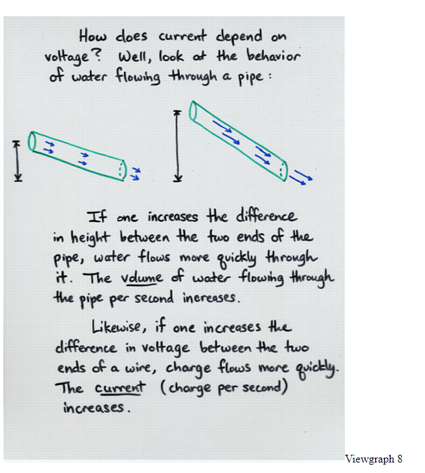
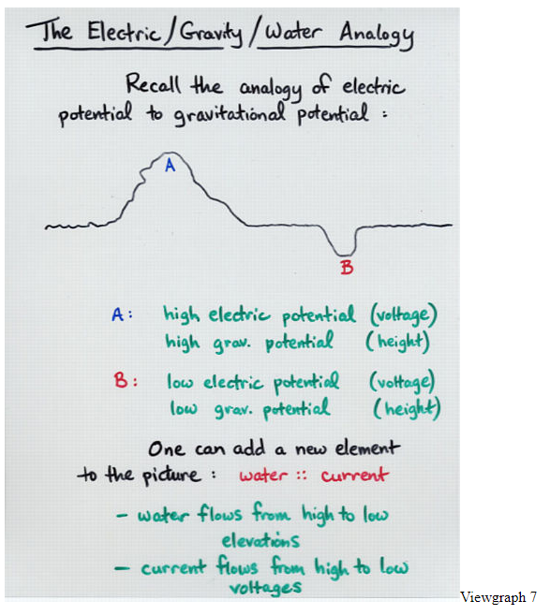
Love this description
Notes:
http://spiff.rit.edu/classes/phys213/lectures/ohm/ohm_long_long.html

Slide 27
Hydraulic/electric analogy
Water level
As the water level increases, so too does the “pressure” of the water at the bottom of the tank (due to increasing amounts of weight), which will “push” more water out of the tank (increasing flow)
Lowest pressure
(negative terminal of battery)
0 volts
The resistor causes an electrical pressure (voltage) drop. So, the voltage is back to 0V here.
Lowest pressure
(at top of water level)
I = 15mA
R = 100Ω
Water Pressure ≈ Voltage (V) (measured in volts)
Hole width ≈ Resistance (R) (measured in ohms Ω)
Current (I) flows from high to low pressure
The resistor resists the flow of current and the voltage (pressure) drops. The larger the resistor, the less current.
Highest pressure
(positive terminal of battery)
1.5 volts
Highest pressure
(at bottom of tank)
Water Flow ≈ Current (I) (measured in amps or A)
Based on figures from: Platt, Make: Electronics, 1st Edition

Slide 28
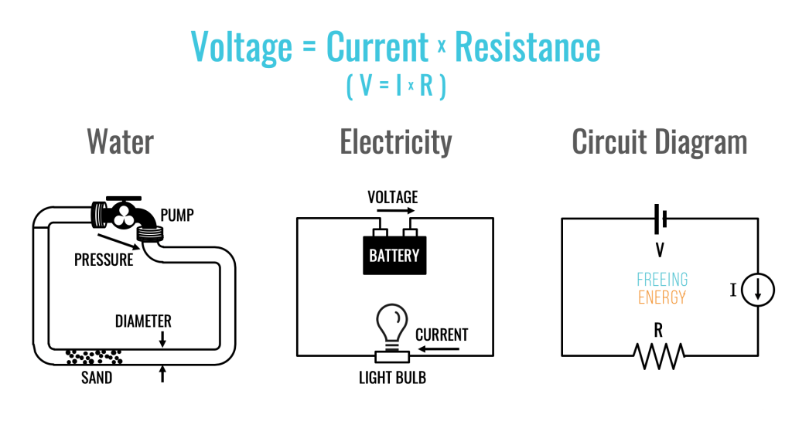

Slide 30
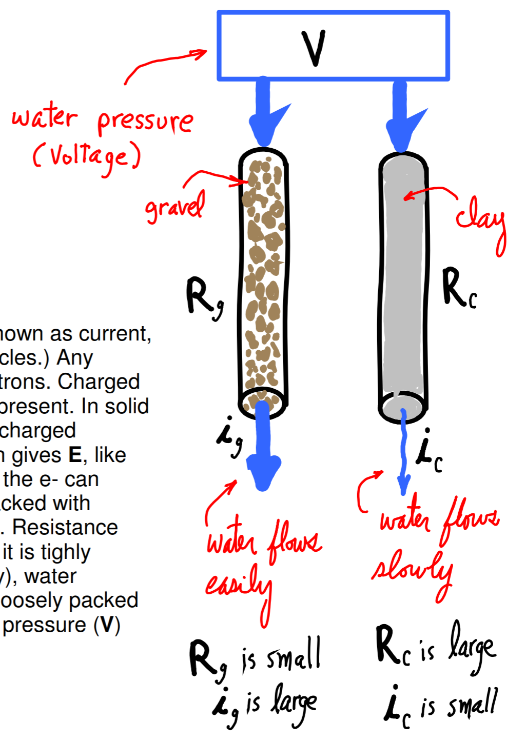
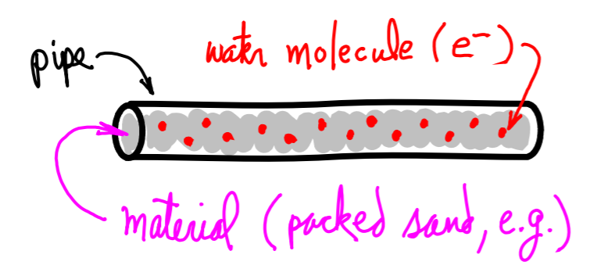

Slide 31
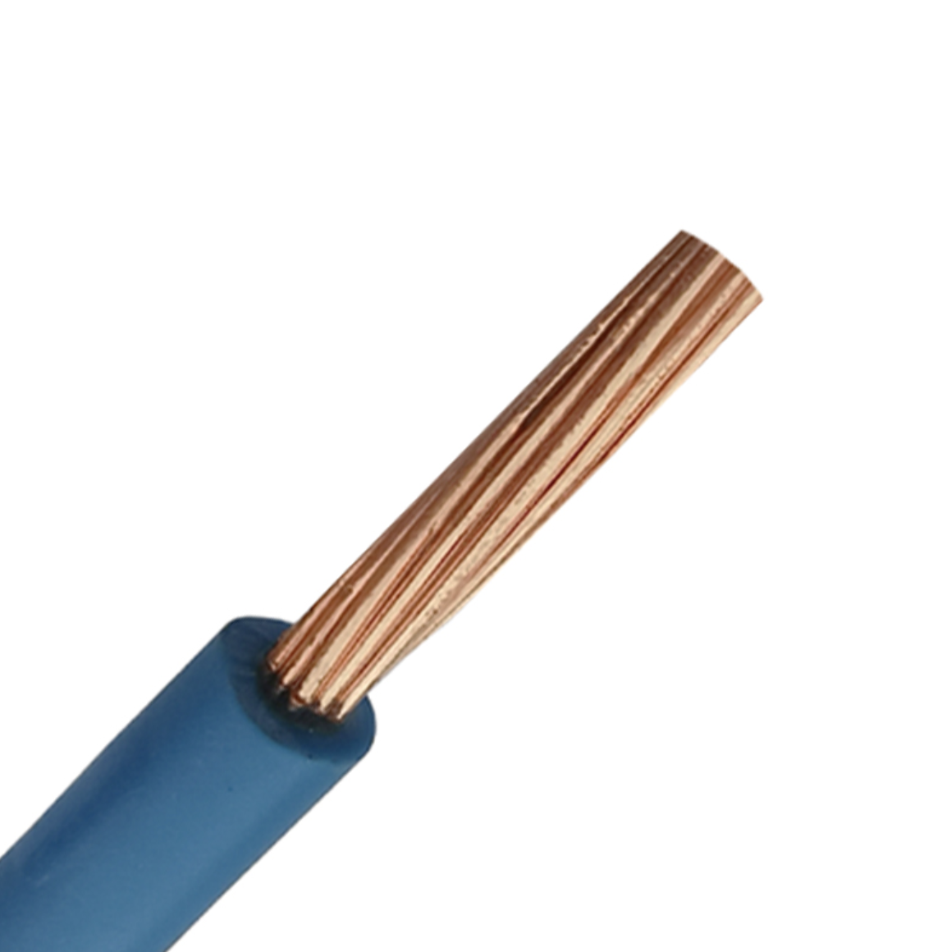

Slide 32
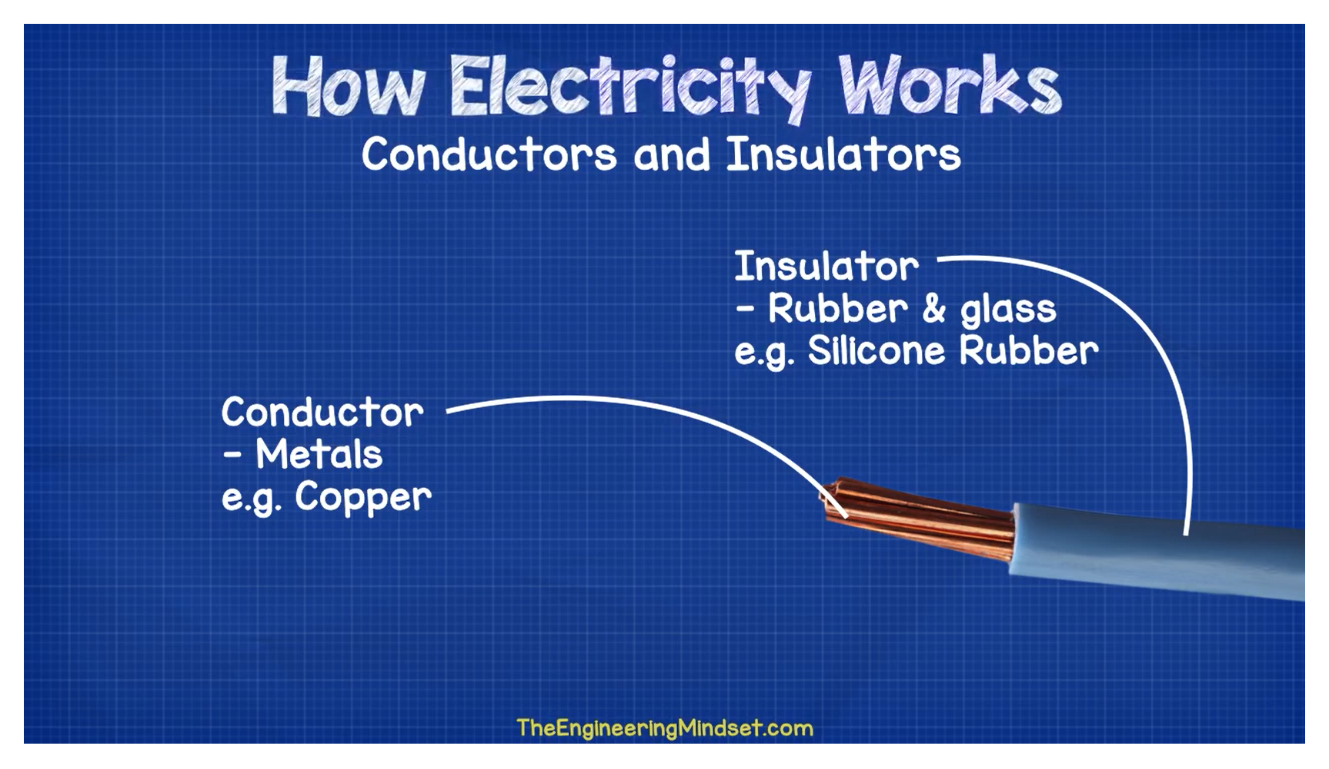
Notes:
https://youtu.be/mc979OhitAg

Slide 33
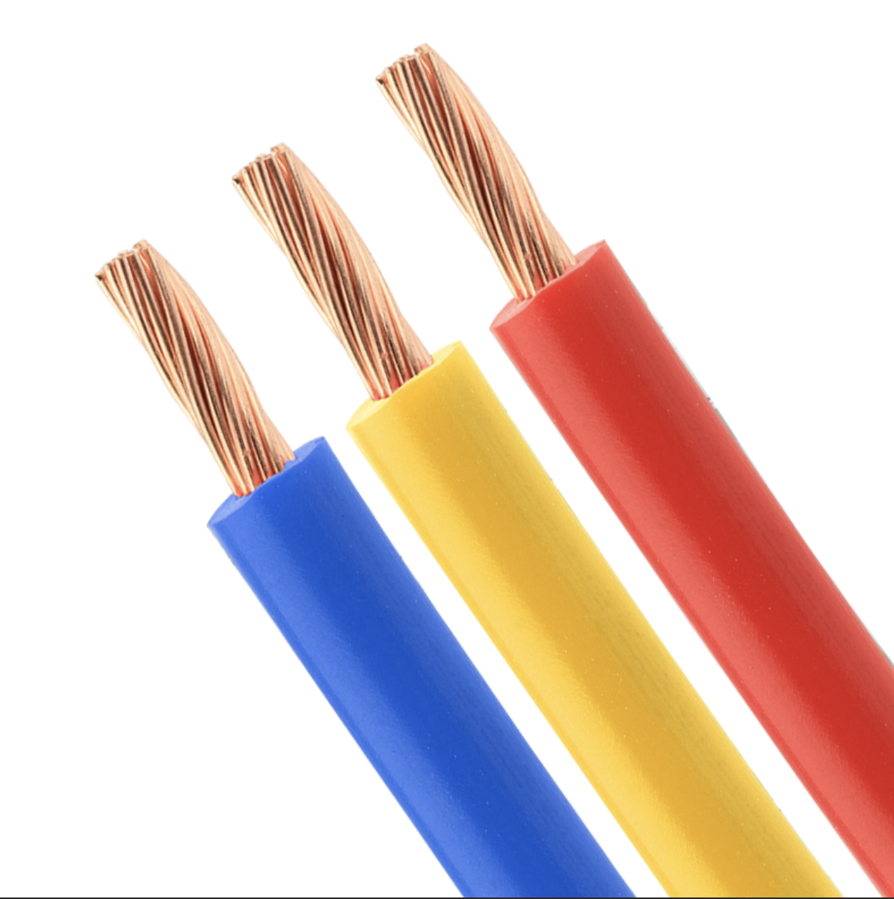
Wires are made of highly conductive material (i.e., with low resistance) such as copper

Slide 34
Conductors
Wires are made of highly conductive material (i.e., with low resistance) such as copper
Insulators
To prevent short circuits and electrical shocks, wires are wrapped in insulative material with low conductivity such as rubber or PVC

Slide 35
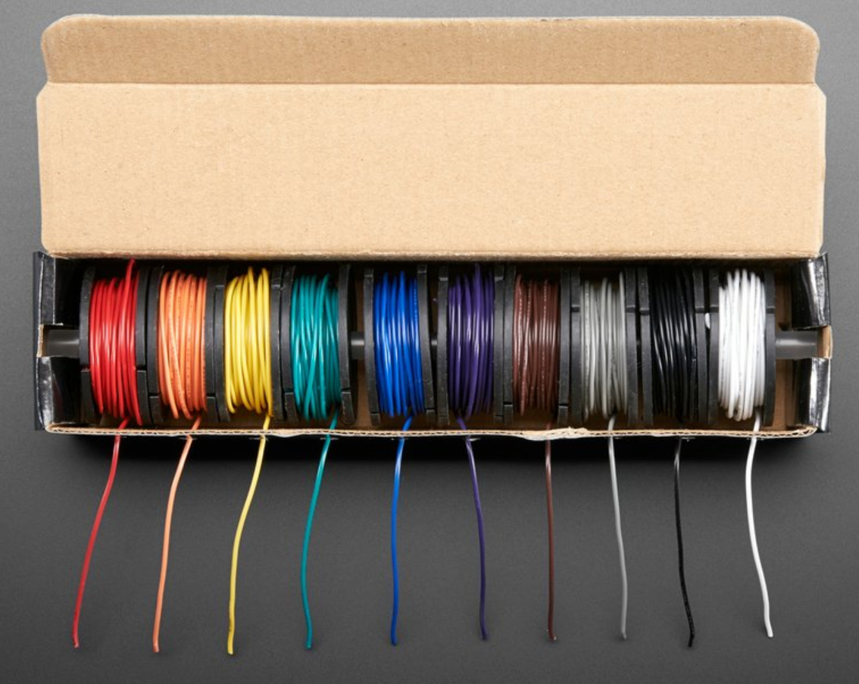
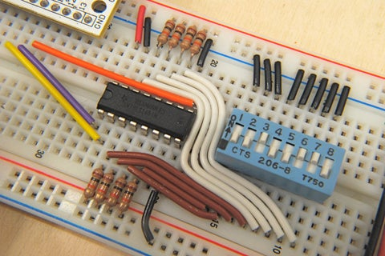
Standard solid-core circuit prototyping wire is 22 AWG

Slide 36
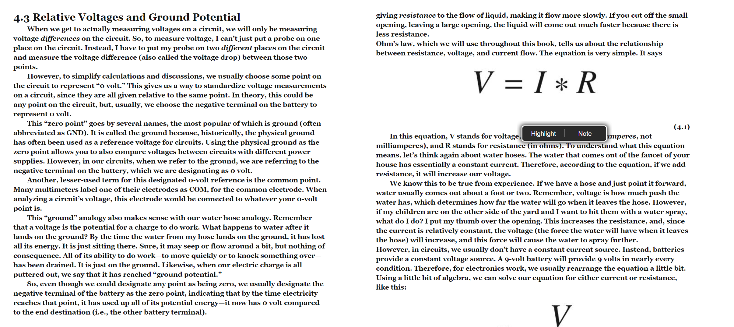

Notes:
https://learning.oreilly.com/library/view/electronics-for-beginners/9781484259795/html/488495_1_En_4_Chapter.xhtml

